Slide 1
3D Object Based Model of Solar System
Team: Fake Astronauts
Nikolai Panergo, Zilin Dong, Zachary Hosek, Claudia Soria, David Saval

Slide 2
Introduction
Task: Create a class based 3D model and animation of our Solar System
Recap: Previously we had class based system set up for our solar system which had an add body, draw, get position, and motion functions. We had a second body class for generating the bodies(planets). We had used different a couple different ODE methods to try and decide what we wanted to use. We tested Euler, Euler Cromer, Midpoint, and 4th Runge-Kutta methods.
Overview: We finished the project by completing our class based system, finding actual data for planet positions using the skyfield library, creating graphics and datasets, and finally using our class based system to animate the solar system.

Slide 3
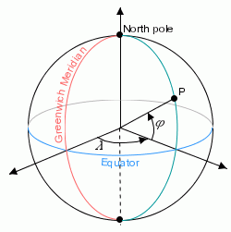
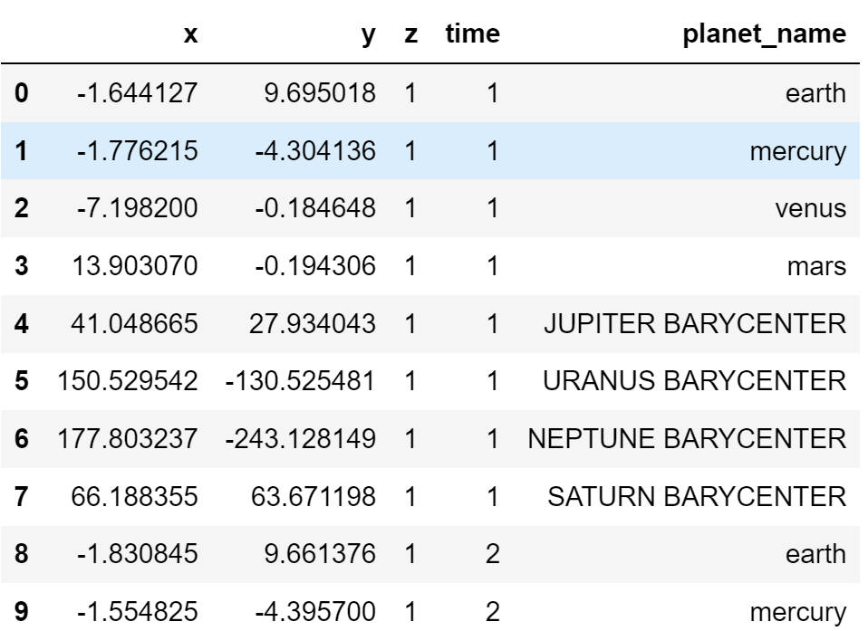
Using Actual Data
Used the python skyfield astronomy library, which has accurate estimations of planet positions up to 0.0005 arcseconds (very very accurate) with the astronomical almanac by the Navy
Heliocentric orbits, converting heliocentric coordinates into x,y,z, with the Sun’s position at (0,0,0)
Units are in AU, which are 150 million kilometers
Data is incremented by a day, every day in 2000 upto 2001
Time measured in UTC, or Greenwich time
Notes:
Zach

Slide 4
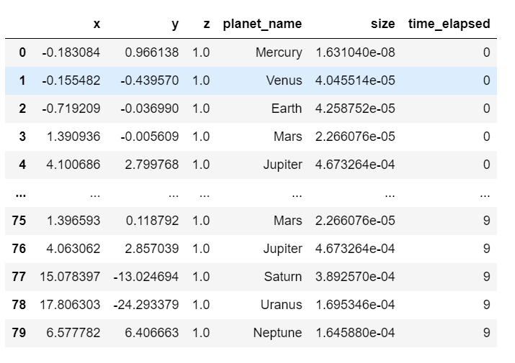
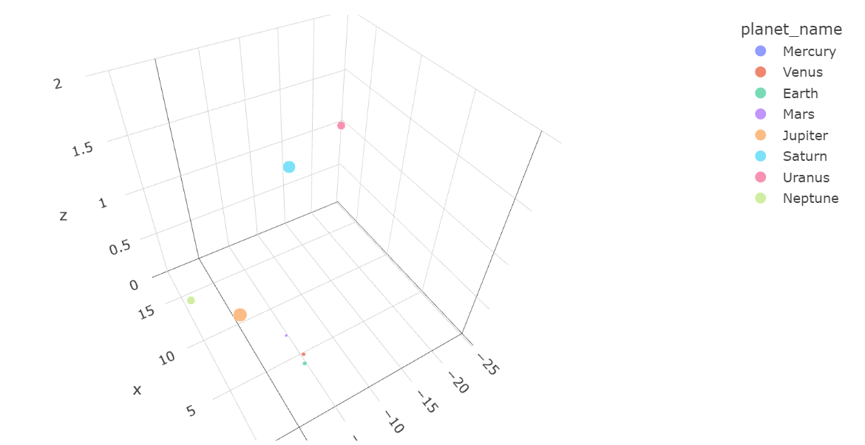
Creating Graphics and Datasets
Using dataframe objects to animate graphs in plotly
Solar system objects are able to keep body objects in lists
Body objects have coordinates which are changed based on different numerical methods
(Barycentric just means center of gravity)
(Actual)
(Simulated)

Slide 5
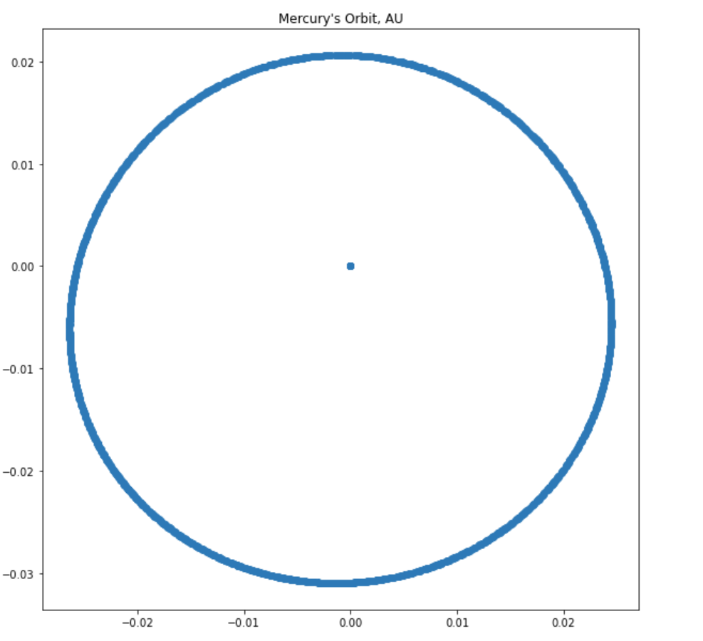
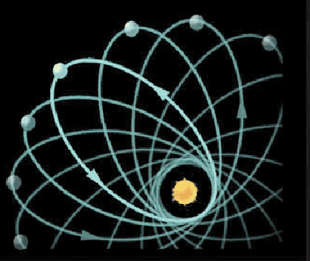
Interesting Observations
Mercury’s Strange Orbit
Graph is from 1900 to 2050
Mercury’s precession of perihelion not found (Sun at (0,0))
9.5 arcminutes per century, so wasn’t very visible on our time range

Slide 6
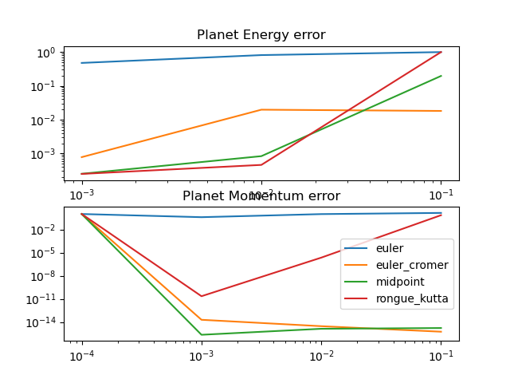
Numerical Methods
Space Complexity of ODE methods:
Euler’s method: O(N)
Euler Cromer’s method: O(N)
Midpoint Method: O(N)
4th Runge-Kutta O(4N)

Slide 7
Animation
Please see github repo for animation

Slide 8
Questions

Slide 9
Special Libraries Used:
Skyfield
Plotly

